Slide 1
Solar Energy/Convection Zones/Storms

Slide 2

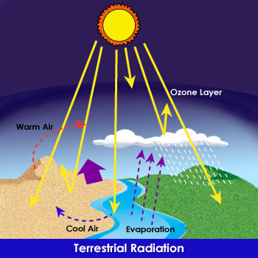

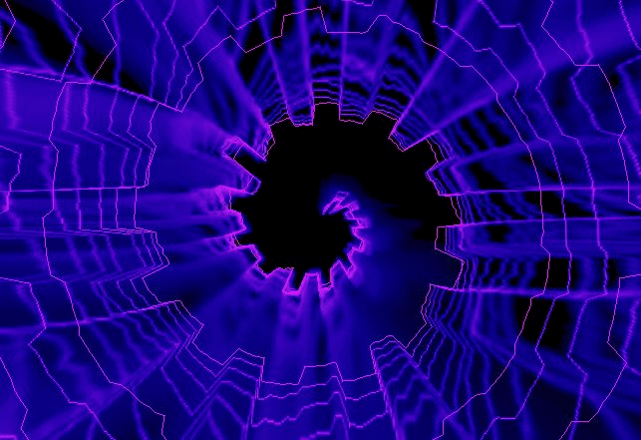
Solar energy
Some of the Sun’s energy coming through Earth’s atmosphere is reflected or absorbed by gases and/or clouds in the atmosphere.
MENU

Slide 3
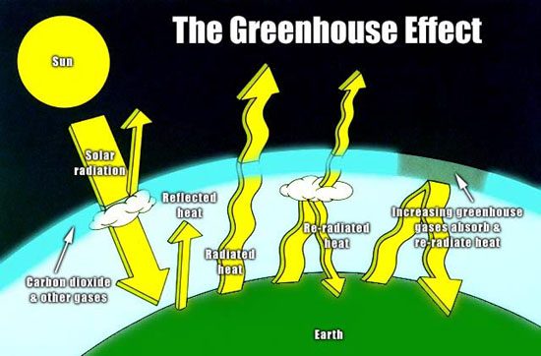
Solar energy
Greenhouse Effect
Solar energy that is absorbed by the Earth’s land and water is changed to heat that moves/radiates back into the atmosphere (troposphere) where gases absorb the heat, a process known as the greenhouse effect.
MENU

Slide 4
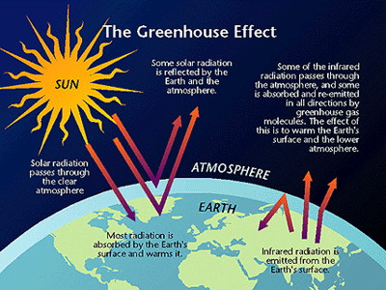
Greenhouse Animation

Slide 5
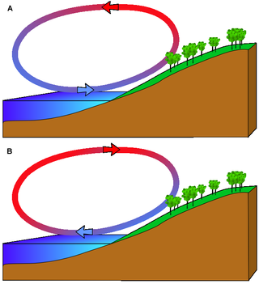
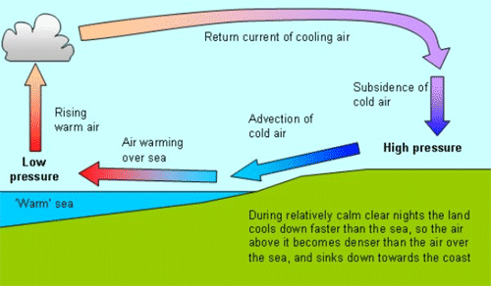
Solar energy
Land heats up and releases heat quickly, but water needs to absorbs lots of solar energy to warm up
This property of water allows it to warm more slowly but also to release the heat energy more slowly
It is the water on Earth that helps to regulate the temperature range of Earth’s atmosphere.

Slide 6
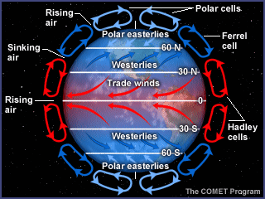
Convection Zones
Because warm air near Earth’s surface rises and then cools as it goes up, a convection current is set up in the atmosphere.
There are three atmospheric convection areas in the northern hemisphere and three in the southern hemisphere.
MENU

Slide 7
Convection Zones
the tropical region begins at the equator and extends to the about 30 degrees north latitude
the temperate region extends from there to about 60 degrees north latitude
the polar region extends from there to the north pole, 90 degrees north latitude.
Convection & Global Winds Video
MENU

Slide 8
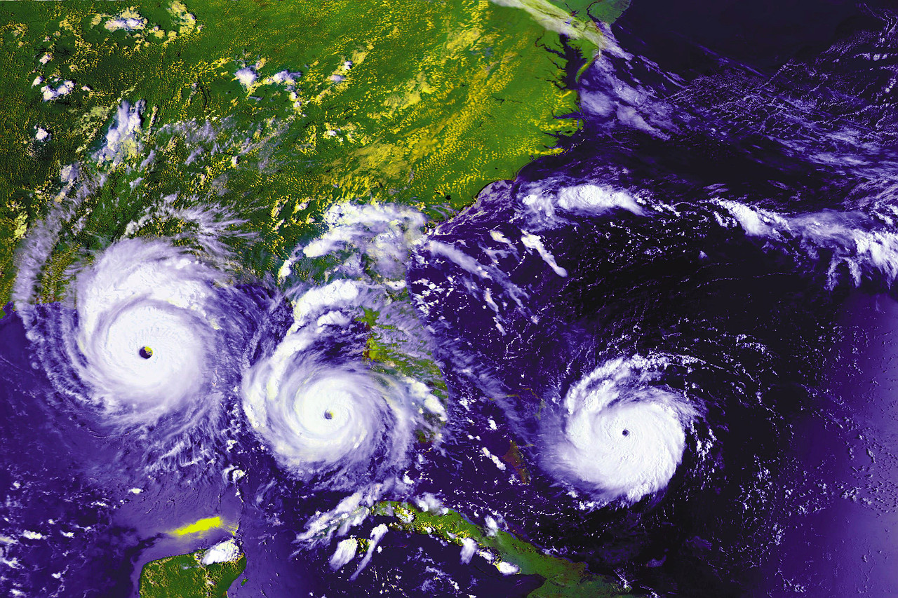
Tropical Weather Systems
Convection Zones
Move in the direction of trade winds
(hurricanes)
If hurricanes enter a westerly wind belt they often turn in direction of prevailing system
MENU

Slide 9
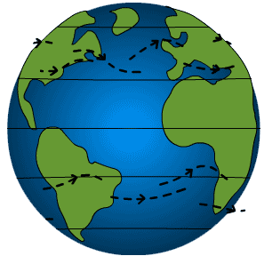
Jet Stream
Convection Zones
Fast moving ribbon of air that moves around Earth
Dips and bends & is constantly changes positions
Air masses & weather systems in its path are moved by the fast moving air
Polar jet stream bring cold polar conditions from north
Subtropical jet stream bring warm tropical conditions from south
MENU

Slide 10
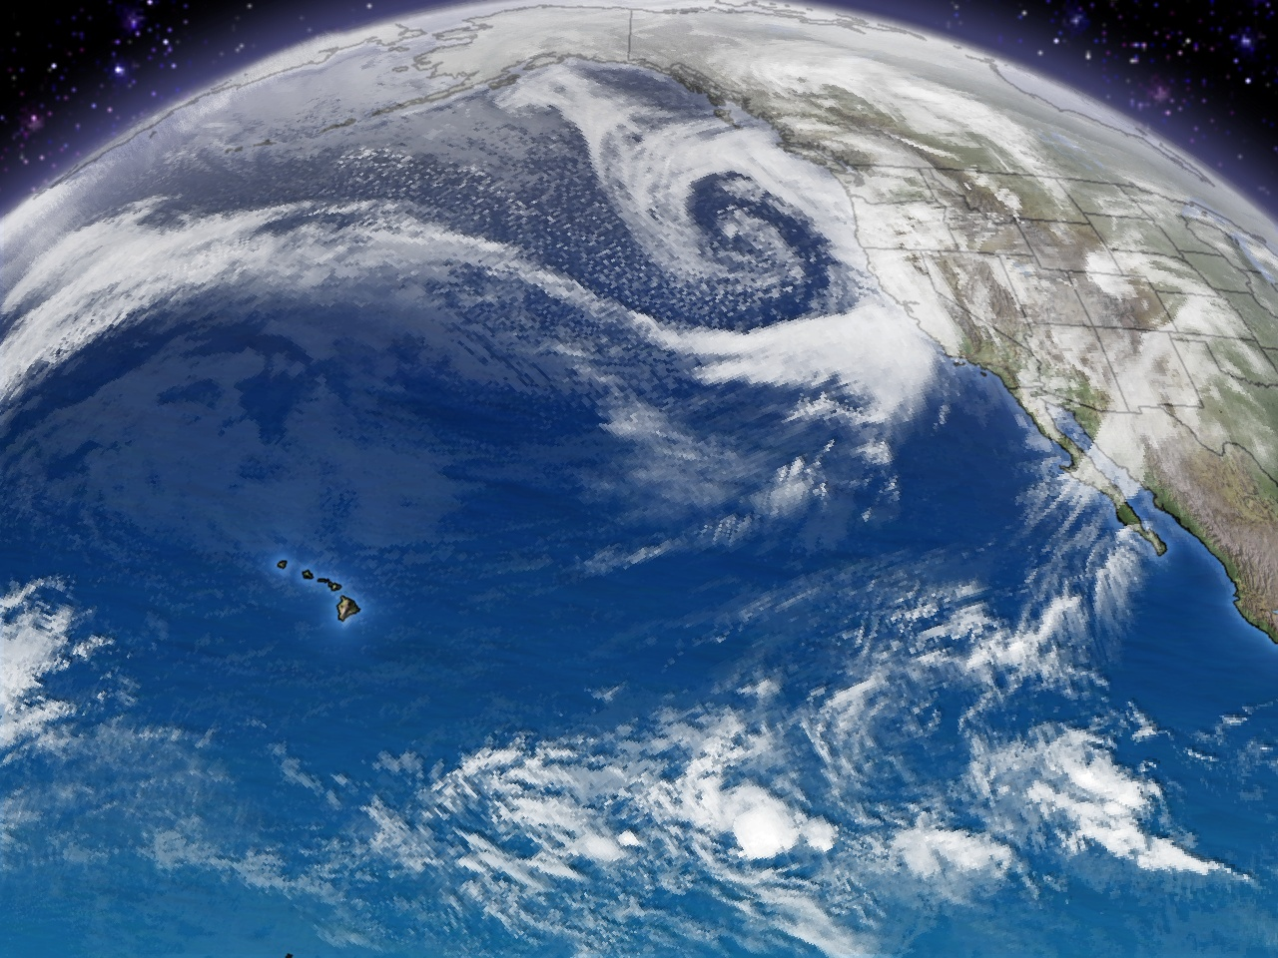
storms
Storms
· Severe weather conditions
called storms occur when
pressure differences cause
rapid air movement.
· Conditions that bring one kind of storm can also cause other kinds of storms in the same area.
Severe Weather 15:09
Monsoons 11:21
Rain or Shine: Understanding the Weather Video 13:44
MENU

Slide 11

storms
Thunderstorm is storm with thunder, lightning, heavy rains and strong winds; form within large cumulonimbus clouds; usually form along a cold front but can form within an air mass.
Thunderstorm Formation Animation
Lightning Animation
Weather Smart Video 14:59
Real Thunderstorm Animation
MENU

Slide 12
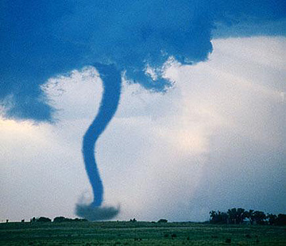
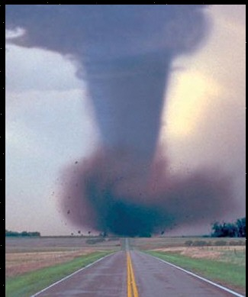
storms
A tornado is a rapidly whirling, funnel-shaped cloud that extends down from a storm cloud; the very low pressure and strong winds can cause great damage to people and property.
Tornadoes are likely to form within the frontal regions where strong thunderstorms are also present.
Tornado Wind Patterns Animation
MENU

Slide 13
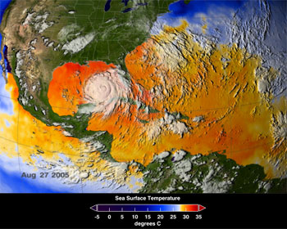
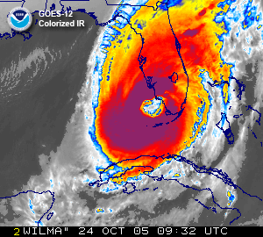
storms
A hurricane is a low pressure tropical storm that forms over warm ocean water; winds form a spinning circular pattern around the center, or eye, of the storm.
The lower the air pressure at the center, the faster the winds blow toward the center of the storm.
Science Daily- Hurricanes
MENU

